Slide 1

Team Project 1 - CAP
Git & GitHub

Slide 2
Version Control
What is “version control”?
Version control is a system that records changes to a file or set of files over time so that you can recall specific versions later.
why should you care?
Revert selected files back to a previous state.
Revert the entire project back to a previous state.
Compare changes over time.
See who last modified something.
Who introduced an issue and when.

Slide 3
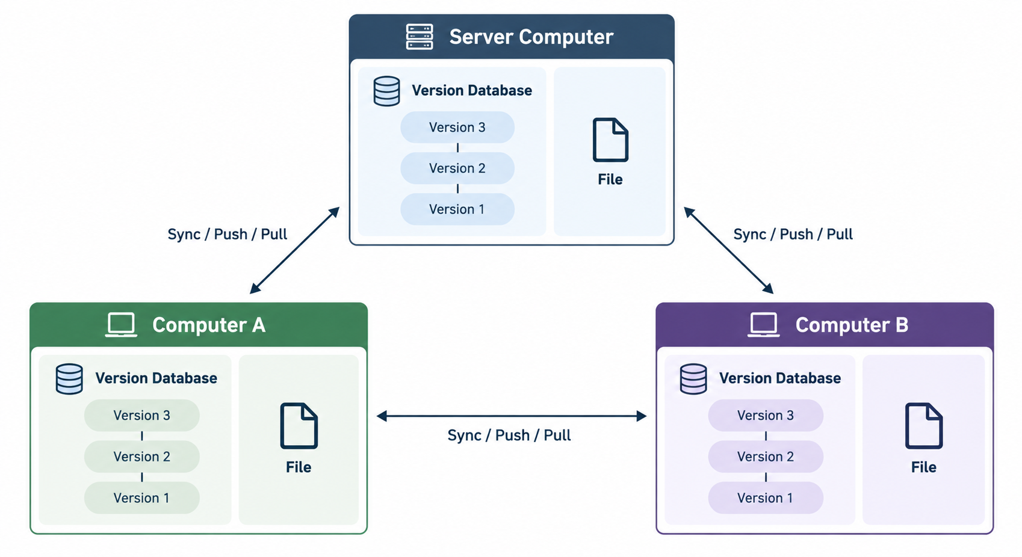
Distributed Version Control Systems
DVCS (such as Git, Mercurial or Darcs), clients don’t just check out the latest snapshot of the files; rather, they fully mirror the repository, including its full history.

Slide 4
Introduction to Git
Git is a popular version control system (VCS), it is a free, open source tool that helps you save and manage different versions of your files and code.
Distributed Version Control System (DVCS).
Records changes in files over time.
Allows developers to collaborate.
Supports branching, merging, and tracking history.
Tracks changes using sanpshots of a project.
Example:
Team A works on feature-login.
Team B works on feature-payment.
Git allows both teams to work independently and later merge changes.

Slide 5
Introduction to Git
Three Main States:
Modified → file changed
Staged → selected for the next commit
Committed → safely stored in the local repository
The basic Git workflow:
You modify files in your working tree.
You selectively stage just those changes you want to be part of your next commit, which adds only those changes to the staging area.
You do a commit, which takes the files as they are in the staging area and stores that snapshot permanently to your Git directory.

Slide 6
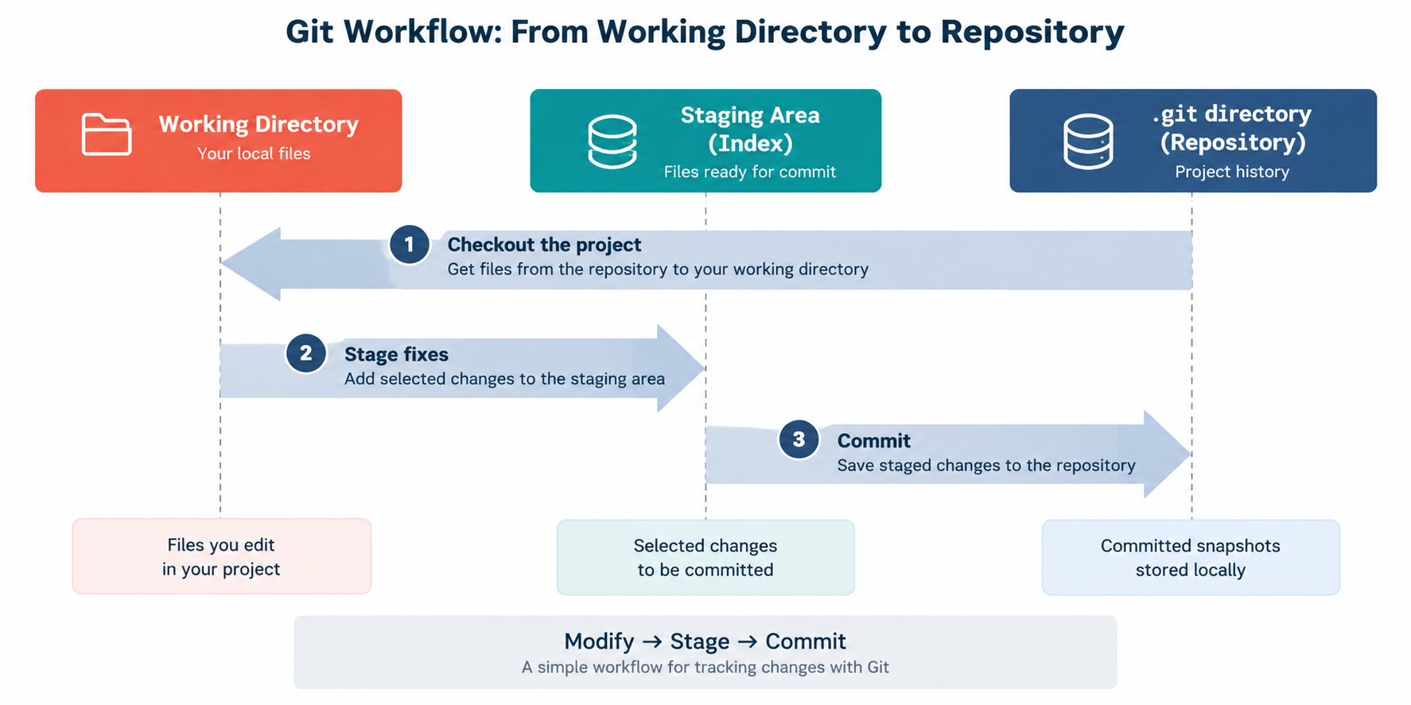
Introduction to Git

Slide 7
Install Git
You can download Git for free from git-scm.com.
Install package based on OS (Windows, macOS, Linux)
After installation, you will be able to use Git from your terminal or command prompt.
Verify installation:
</> Bash
$ git --version
Expected output:
</> Bash
git version 2.45.1

Slide 8
Configure Git
The first thing you should do when you install Git is to set your user name and email address. This is important because every Git commit uses this information, and it’s immutably baked into the commits you start creating.
Set your user name:
</> Bash
$ git config --global user.name “Amjad”
Set your email:
</> Bash
$ git config --global user.email “amjad@example.com”
Verify the configuration:
</> Bash
$ git config --list

Slide 9
Getting help with Git
If you ever need help while using Git, there are three equivalent ways to get the comprehensive manual page (manpage) help for any of the Git commands:
</> Bash
$ git help <command>
$ git <command> --help
$ man git-<command>
Example:
</> Bash
$ git help config

Slide 10
Getting Started with Git
You typically obtain a Git repository in one of two ways:
You can take a local directory that is currently not under version control, and turn it into a Git repository, or
You can clone an existing Git repository from elsewhere.
Initializing a Repository in an Existing Directory
</> Bash
$ cd path/to/the/directory
$ git init
Cloning an Existing Repository
</> Bash
$ cd path/to/the/directory
$ git clone https://github.com/libgit2/libgit2

Slide 11
New file in Git
Each file in your working directory can be in one of two states: tracked or untracked.
When you create a new file, Git doesn’t track it automatically.
Git sees it as Untracked.
Check with: git status
Note: Tracked files are files that were in the last snapshot, as well as any newly staged files; they can be unmodified, modified, or staged. In short, tracked files are files that Git knows about.
Cloning an Existing Repository
</> Bash
$ echo “Hello Git” > hello.txt
$ git status

Slide 12
Staging Modified Files in Git
Tracking New Files:
In order to begin tracking a new file, you use the command git add.
</> Bash
$ git add README
</> Bash
$ git status
On branch master Your branch is up-to-date with 'origin/master'. Changes to be committed:
29 (use "git restore --staged <file>..." to unstage)
new file:
README

Slide 13
Staging Modified Files in Git
Staging Modified Files:
If you change a previously tracked file called CONTRIBUTING.md and then run your git status command again, you get something that looks like this:
</> Bash
$ git add CONTRIBUTING.md
</> Bash
$ git status
On branch master Your branch is up-to-date with 'origin/master'. Changes to be committed:
(use "git reset HEAD <file>..." to unstage)
new file:
README
Changes not staged for commit:
(use "git add <file>..." to update what will be committed) (use "git checkout -- <file>..." to discard changes in working directory)
modified:
CONTRIBUTING.md

Slide 14
Commits in Git
Committing Your Changes:
A commit records a snapshot of the files currently in the staging area.
Files that have not been staged with git add are not included in the commit.
Commit Staged Changes:
Example Output:
</> Bash
$ git commit
</> Bash
[master 463dc4f] Fix login broken link
2 files changed, 2 insertions(+)
create mode 100644 README
Commit with a Message:
</> Bash
$ git commit –m “Fix Login broken link”
Working Directory → git add → Staging Area → git commit → Repository
Only staged changes are committed. Each commit creates a snapshot that becomes part of the project's history.

Slide 15
Deleting files with Git
Git can track file deletions just like other changes. A deleted file is not removed from previous commits - it remains available in the repository history.
Delete & Stage a File: (The recommended Git command)
Deleting file manually:
</> Bash
$ git rm notes.txt
Git detects the deletion
But you still need to stage it
Then commit:
This performs two actions: Deletes the file + Stages the deletion
Then commit the change

Slide 16
Restoring deleted files with Git
Before staging:
If the deletion is already staged:
</> Bash
$ git restore notes.txt
</> Bash
$ git restore --stages notes.txt
$ git restore notes.txt
Deleting a tracked file does not erase its history. Git records the deletion as a new change, while previous versions remain in earlier commits.

Slide 17
Git Tag
The git tag command is used in Git to create, list, delete, or verify tags.
Tags are essentially labels or bookmarks for specific points in your project's history, often used to mark releases.
Label a commit (for versions/releases)
Creating Tag:
Deleting Tag:
</> Bash
$ git tag v1.0
//or using annotated tag
$ git tag –a v1.0 –m “my version 1.4”
</> Bash
$ git tag –d v1.0
listing Tags:
</> Bash
$ git tag
V1.0

Slide 18
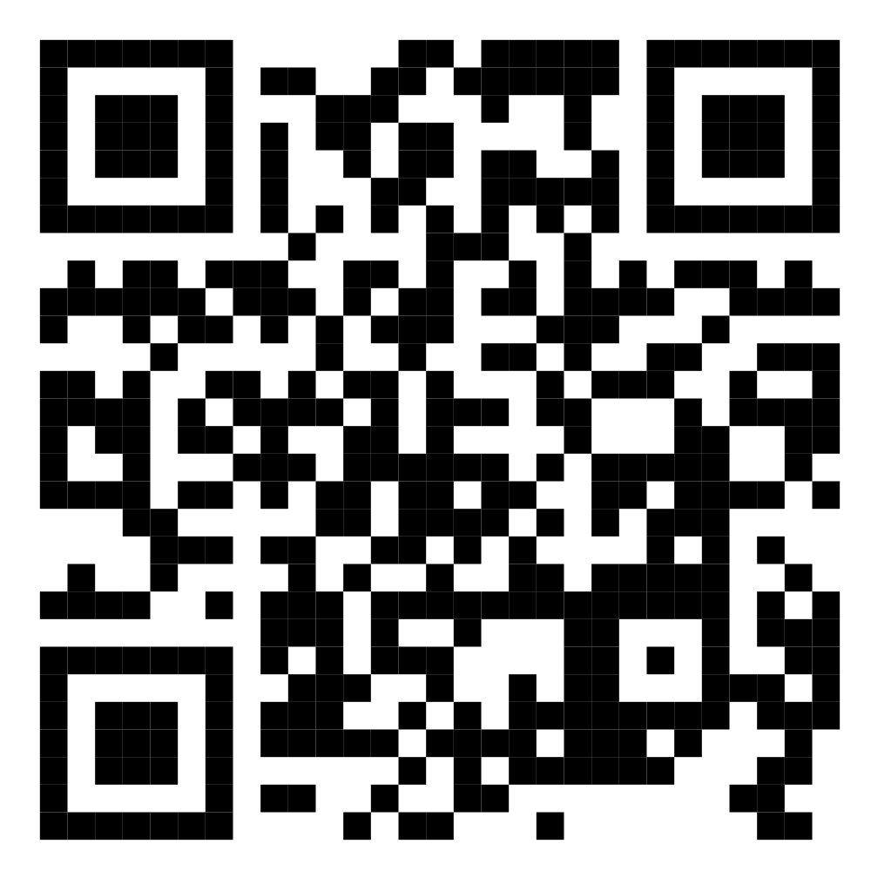
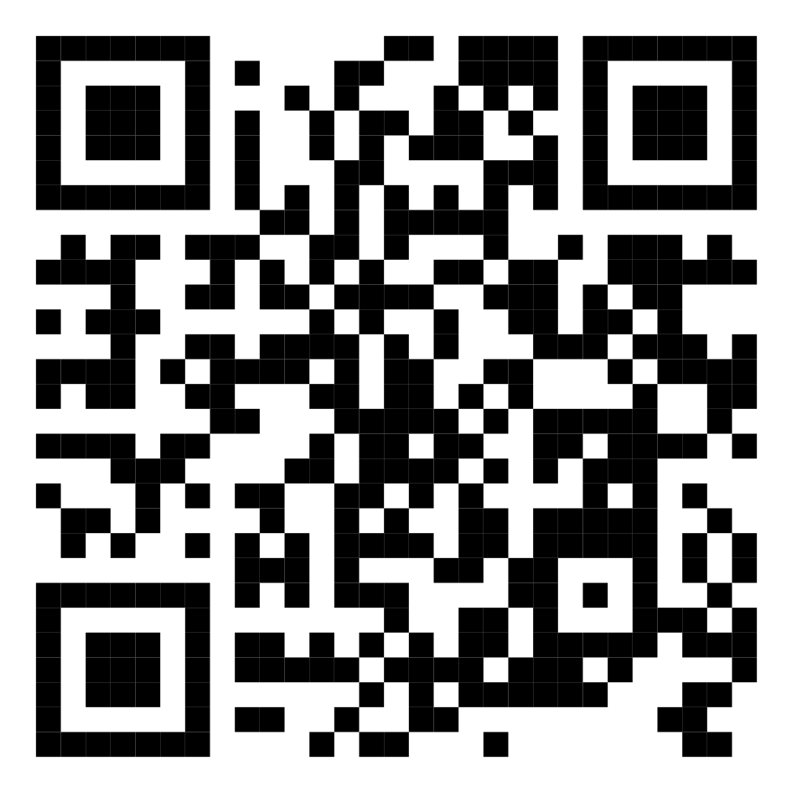
Author
Amjad Ataallah
Yanal Sweseh
Email: amjad.atallah@najah.edu
Linkedin: https://www.linkedin.com/in/ataallah/
Website: https://amjadataallah.github.io
Email: yanal.swaseh@najah.edu
Linkedin: https://www.linkedin.com/in/yanalsweseh/
Website: https://github.com/yswesieh

